Slide 1
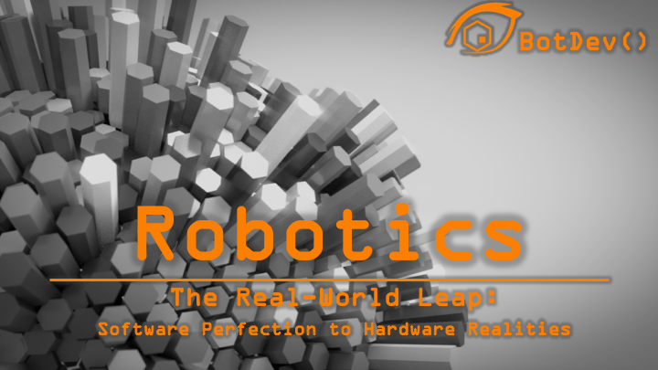

Slide 2
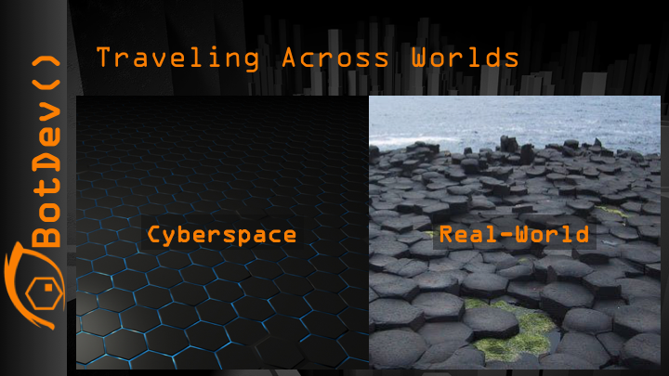
Notes:
Cyberspace is perfection; things behave the way you expect them to. In the real-world, however, things are never that cut and dry. In the real-world tires slip, gears have slight imperfections. Motors of the same model may have slight variations in performance. In the real-world surfaces are uneven, fluid, and unpredictable. In cyberspace 3D designs are exact, but 3D printers and other fabrication machines never produce perfect replicas of 3D models. And unlike cyberspace, the real-world is dynamic in unpredictable ways. A robot is a mechanical device capable of performing a variety of tasks by being programmed in advance. Robotics is a bridge between the predictable, exacting cyber-world and the volatile, imperfect real-world. Robots perform all kinds of functions from a refrigerator making ice to performing patient care tasks and exploring other planets. Robot designers and programmers must make robots capable of handling the unknown, mitigating the unexpected, and can constantly correct themselves reacting to the dynamism of the real-world.

Slide 3
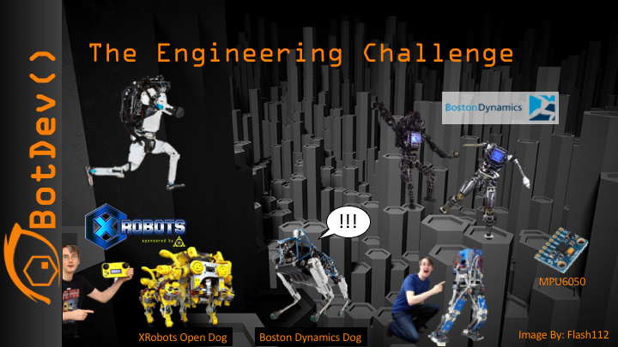
Notes:
Even for a human the simple act of balancing or coordinated movement requires the synthesis of massive amounts of information coming for organs of the vestibular system in the inner ear, feedback from muscles, and visual information from eyes. Engineers that take on the challenge to replicate this capability in robots are at the forefront of the robotics development field. But would it surprise you to learn this this technology is widely used and employed by do-it-yourself-ers and high-school students all over the world. In fact the technology that makes this possible in robots like Boston Dynamics’ bipedal robot, Atlas –pictured here-, is the same technology used in racing drones and hover boards. In fact you can produce the data you need to balance a robot from a three dollar MPU6050. But the challenges don’t end with balance. The real-world is the ultimate foe for an engineer, but what is important to remember is that despite the challenge the technology to produce robots is cheap and available. In an upstairs room of his home, James Bruton of XRobots has replicated many of Boston Dynamics amazing robotic feats with nothing more than a CAD program, a 3D printer, and widely available electronics and components. Let’s take a closer look at the challenges robotics engineers face.

Slide 4
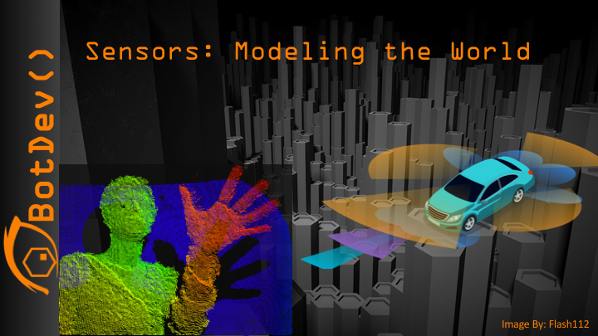
Notes:
We tend to take our sense for granted and never really think of what an amazing task it is to detect and build a mental representation of our world. Consider the old Zen question (Koan). If a tree falls in the woods and no one is around to hear it, does it make a sound. The answer: No! Trees don’t makes sounds, ears do! A falling tree makes vibrations and our ears convert those vibrations into electrical signals that we experience as sound. In fact, all human sense organs convert stimuli from the environment into electrical signals that the brain interprets. Robots work the same way, expect robot sensors don’t make sensations they make data. The robot can then be programmed to interpret that data to model the world around them and take action based on that model. But its is important to realize that robots don’t simply need to detect the world around them they need to produced coordinated interaction with the world, which as we saw earlier is dynamic, unpredictable, the infinitely irregular.

Slide 5
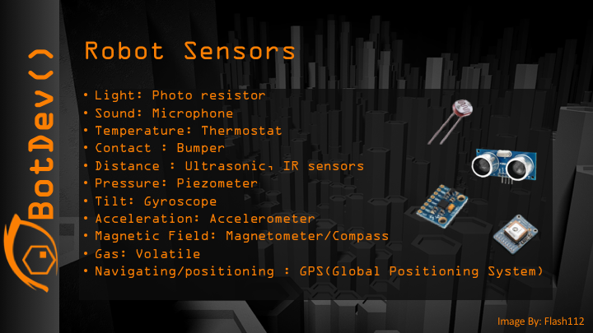
Notes:
For this reason, there are 100s of different types of sensors, each unimportant until you need them! Photo resistors measure the intensity of light and microphones measure the intensity, amplitude, and frequency of sound waves. Thermostats measure heat and like humans robots not only need to know what’s going on in their environment they need to what going on in the own systems and mechanisms. Thermostats are often used to shutdown or throttle down overheating processors, or power regulation systems. Bumpers are used to tell the robot when they have made physical contact with an object in the real-world. A large variety of distance sensors such as ultrasonic, laser, and infrared sensors detect objects and constraints at a distance. Data from these distance sensors is also used to map and model the physical environment. Very sensitive pressure sensors like piezometers and piezo microphones are crystals that when compressed emit an electrical charged. These sensors can even detect the pressure exerted by sound waves. There are a specific set of sensors to tackle the huge problem of balance. A gyroscope can detect a tilt or change in articulation. They do this because spinning mass tends to resist change in articulation. Accelerometers use the properties of inertia to detect acceleration in any direction… including rotational acceleration. A Magnetometer works like a compass and can provide your robot with one consistent directional bearing, provided there are no other strong magnetic fields around. There are a host of sensors that can detect various gases and chemicals in the air. And of course, there is Global Positioning System sensors. GPS sensors can give you a grid coordinate anywhere in the world within 3 feet!

Slide 6
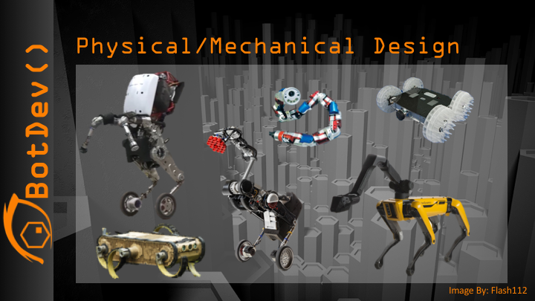
Notes:
Now that we know how to model the world around the robot, detect objects in it, and determine the robots position and articulation in reference to that model, how can our robot traverse this world and interact with objects in it? We often think of robots as a humanoid form, but the human form is a general purpose design. Robots may have much more specific roles and tasks; therefore their design is often purpose-driven and can look quite odd.

Slide 7
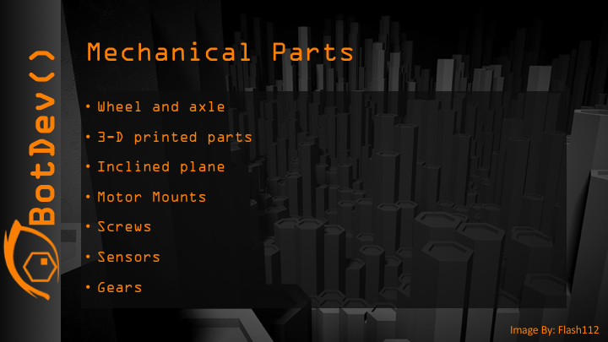
Notes:
Mechanical engineers design and create parts to these weird contraptions. You will need to consider everything you need to make your bot. You will put all of this in a ”Bill Of Materials” or BOM. Your BOM is a critical part of designing. It will help you generate a cost for your bot, and figure out where you can make it more cost effective or improve its design. When selecting and designing parts for your bot you need to consider characteristics like required load capacity –how much weight the part needs to withstand-, maneuverability, durability, functionality, traction, heat tolerances, as well as the environment in which the bot will operate.

Slide 8
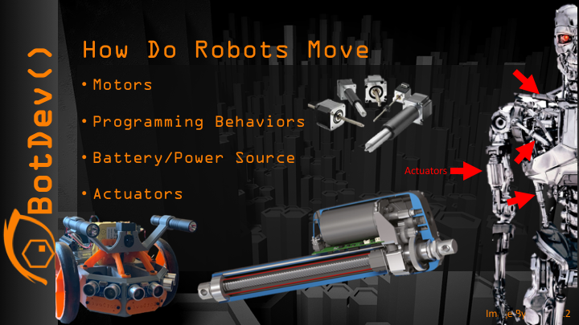
Notes:
Moving isn’t always as simple turn right turn left. The STEMBot has two stepper motors. To move forward the both must turn toward the front of the bot. To turn one must turn toward the rear and one toward the front of the bot, and so on. Robots with arms or appendages often utilize actuators. Actuators are most often either pressure driven or screw driver pistons that produce linear movement. All movement in a bot will require some kind of programmed coordination of multiple motors or actuators, joints, wheels, and other movement components.

Slide 9
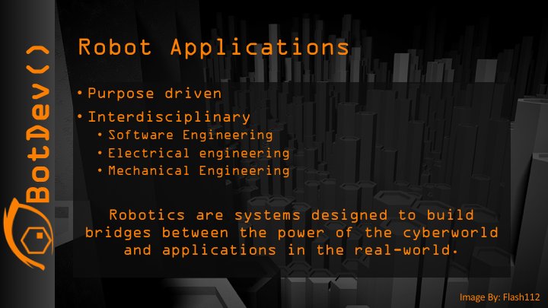
Notes:
Robot designers create robots to solve real-world problems. The power of the cyberworld allows creators to make robots that can autonomously perform tasks and roles without the need for sleep, food, or entertainment, but this capability comes at a high price. Unlike biological organisms that have evolved to interact with their environment, robots can only do what they are programmed to do. This means robots do not handle novelty very well, and this is a big problem because robots have to face an unpredictable, volatile world where the only thing certain is uncertainty. Robot designers must tackle these dilemmas by building robots that focus on specific task and environments. Let’s take a look at some of them.

Slide 10
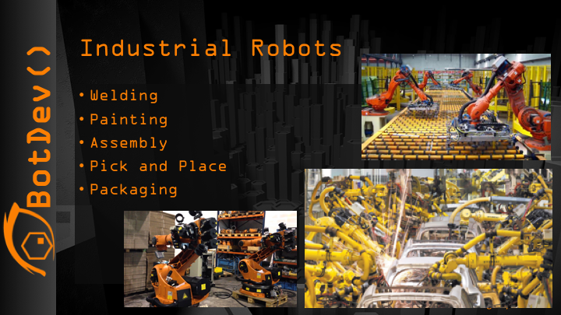
Notes:
No where have robots been more successful than in industry. Why are they so successful here. Robot designers are able to escape the harsh realities of the real world by shutting it out.. Robots in a factory or other industrial setting often are in controlled predictable environments where the robots position is known. The entire factory may share information so each bot knows where objects of interest are located. Everything is right where its supposed to be, allowing the extremely accurate movements of robots to do their job very quickly.

Slide 11
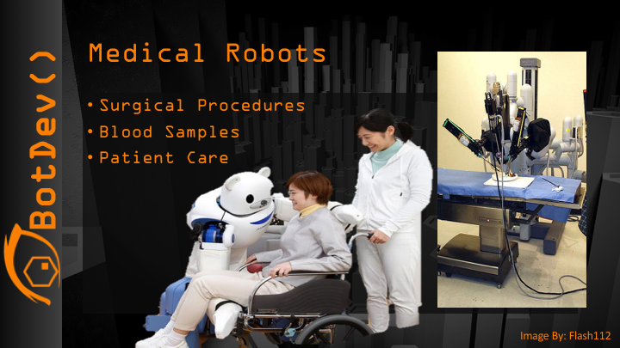
Notes:
If the industrial robots are too safe for you, medical robots should give you the high-risk high-reward endeavor you are looking for. Whether picking up and carrying a fragile patent or actually conducting surgery medical robot designers engage in high-stakes white-knuckle challenges that are literally a matter of life and death.

Slide 12
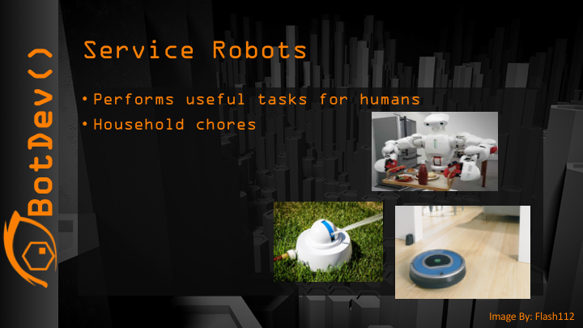
Notes:
It should be no surprise to see a rise in consumer robots that handle the menial tasks we don’t want to do, or to assist the physically challenged. However, with what we know of the difficulties of operating in the real world, even a disk shaped robot that sweeps your floors is a monumental achievement for a consumer good.

Slide 13
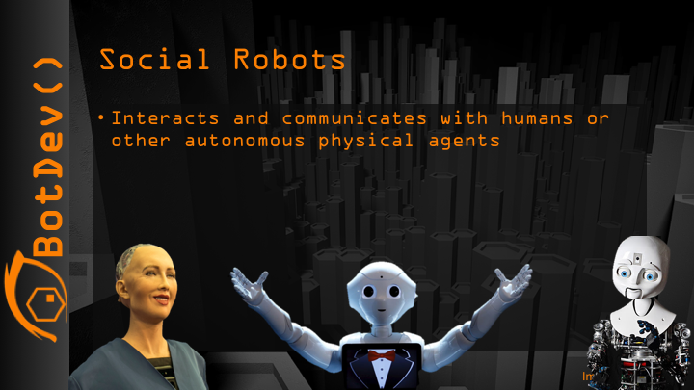
Notes:
Perhaps the farthest frontier in robots is emotion. There is a lot of research and development in social robots who can detect and interpret human emotion, mimic appropriate facial expressions, and connect with humans on a deeper level. But it is not all fun and games. The are researchers that believe robots can be better at determining when a person is a non-combatant or when a person is surrendering and that robots will make better choices in combat than humans. Robots with programmed emotions and ethics is a frontier of science with far reaching implications.

Slide 14
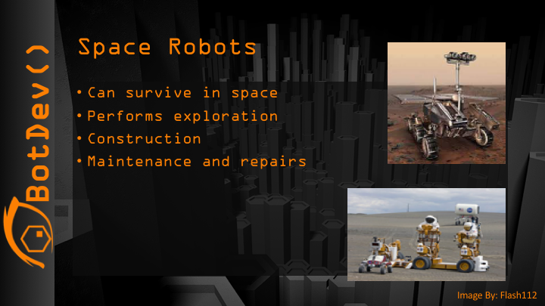
Notes:
Final the mother of all ambition… the highest-cost, biggest, most audacious, highest-risk, lip biting robotics… spacebots! Imagine the robot that you spent decades developing and billions of dollars of tax-payers’ money falls over and the closest it will ever be is 35 million miles away. Imagine that when you send a command to your robot it will take 7 minutes to reach it, and every picture and video it sends back to you will take seven minutes to reach you. Imagine your robot has to navigate some of the toughest terrain out there, with temperature extremes and radiation levels far beyond that of Earth. This is the pinnacle of high stakes robotics.

Slide 15


